Slide 1
How can we develop a National Post-Pandemic Resilience Programme?

Slide 2
Agenda
Timings | Item | Facilitator
15.00-15.05 | Welcome, introductions and report key findings | Dr Alison Giles, formerly Centre for Ageing Better
15.05-15.10 | What is the physiological impact of a reduction in physical activity among older people | Professor Paul Greenhaff, The Physiological Society / University of Nottingham, UK
15.10-15.15 | What steps are the Office for Health Improvement and Disparities and other Government bodies taking to address the reduction in physical activity among older people | Alison Iliff, Office for Health Improvement and Disparities (OHID)
15.15-15.20 | The National Falls Prevention Coordination Group, the impact of COVID-19 and partnership working | Sue Dewhirst, NHS England
15.20-15.25 | Delivering physical activity programmes for older people across Greater Manchester | Beth Mitchell, GreaterSport
15.25-15.55 | Q&A session | Dr Alison Giles, formerly Centre for Ageing Better
15.55-16.00 | Round-up and meeting close | Dr Alison Giles, formerly Centre for Ageing Better

Slide 3
Welcome and introductions
Dr Alison Giles, formerly Centre for Ageing Better

Slide 4
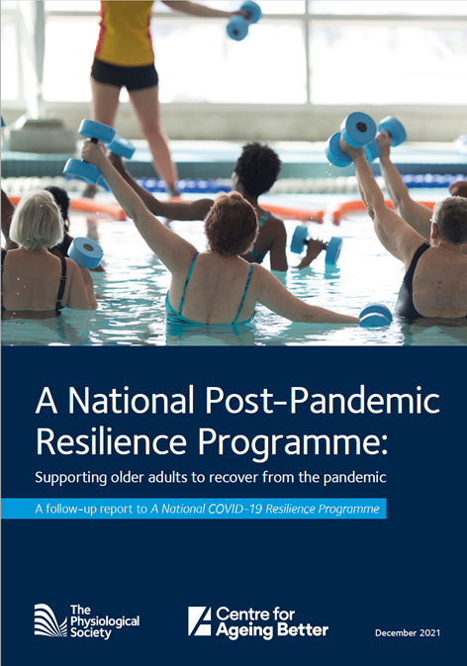
A National Post-Pandemic Resilience Programme
An online version of the report can be found at:
www.physoc.org/covid19resilience

Slide 5
A National Post-Pandemic Resilience Programme
Key findings
26% of all over-50s reported doing less or much less exercise than pre-pandemic
  This was particularly acute in the over-75s (34%)
Different reasons reported by gender
  Women more likely to report a lack of motivation (47% compared to 39% of men)
  Men more likely to report a loss of habit of exercise or socialising in-person (43% compared to 41% of women)
Different age groups reported different preferred actions to help them increase their physical activity levels
  50-59-year-olds preferred activity monitors
  60-74-year-olds preferred social activity groups
  Those aged 75+ preferred tailored advice from a healthcare professional

Slide 6
A National Post-Pandemic Resilience Programme
Main recommendation
We are calling for public health agencies across the UK to launch a National Post-Pandemic Resilience Programme
  This will be a joined-up system of support to provide older people with tailored advice and guidance on how to improve health post-pandemic
  The aim should be to not only return older people to their pre-pandemic physical activity levels, but encourage greater long-term levels of activity

Slide 7
A National Post-Pandemic Resilience Programme
A National Post-Pandemic Resilience Programme should include:
A programme of physical activity to increase physical resilience, focusing on older people with high-risk factors such as obesity, type 2 diabetes, cardiovascular disease and sarcopenia
A specific focus on increasing physical activity of people in their 50s to prevent future frailty
“At home” physical activity options
Clear guidance about the importance of a healthy balanced diet
Steps to embed behaviour change

Slide 8
What is the physiological impact of a reduction in physical activity among older people?
Professor Paul Greenhaff, The Physiological Society and University of Nottingham, UK

Slide 9
What is the physiological impact of a reduction in physical activity among older people
Muscle Mass & Metabolic Health
40’s
Acute inactivity
(e.g. lockdown)
80’s +
---acute anabolic resistance---
Failed Recovery
Acute inactivity plus inflammatory burden

Slide 10
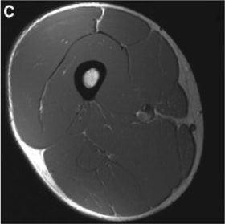
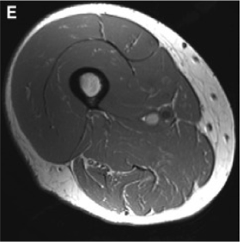
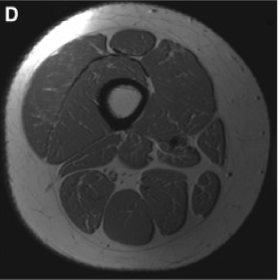
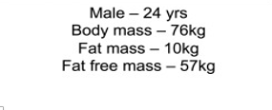


McLeod et al. Biogerontology. 2016 Jun;17(3):497-510.

Slide 11
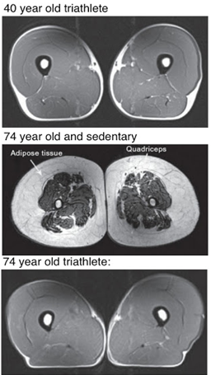
Wroblewski, A., et. al. Chronic Exercise Preserves Lean Muscle Mass in Masters Athletes. The Physician and Sports Medicine. 39, 2011.

Slide 12
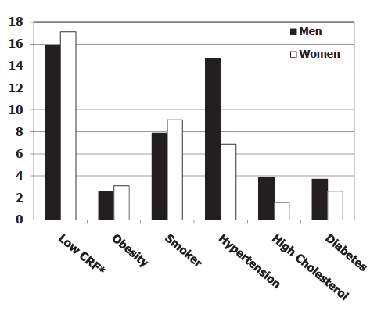
What’s the significance of being inactive?
Blair S.N. British J Sports Med (2009) 43(1):1-2.
Attributable fractions (%) for all cause deaths in 40,842 (3333 deaths) men and 12,943 (491 deaths) women in the Aerobics Center Longitudinal Study.
The attributable fractions are adjusted for age and each other item in the figure.
* = cardiorespiratory fitness determined by a maximal
exercise test on a treadmill.

Slide 13
What steps are the Office for Health Improvement and Disparities and other Government bodies taking to address the reduction in physical activity among older people?
Alison Iliff, Office for Health Improvement and Disparities (OHID)

Slide 14
Addressing the reduction in physical activity among older people
Alison Iliff, Health and Wellbeing Programme Lead
16 December 2021

Slide 15
The Office for Health Improvement and Disparities
Established on 1 October 2021 bringing together health improvement and intelligence functions from PHE and DHSC
Works across government, local government and the health and care system to focus on preventing ill-health and reducing inequalities
OHID will:
identify and address health disparities, focusing on those groups and areas where health inequalities have greatest effect
take action on the biggest preventable risk factors for ill health and premature death including tobacco, obesity and harmful use of alcohol and drugs
work with the NHS and local government to improve access to the services which detect and act on health risks and conditions, as early as possible
develop strong partnerships across government, communities, industry and employers, to act on the wider factors that contribute to people’s health, such as work, housing and education
drive innovation in health improvement, harnessing the best of technology, analytics, and innovations in policy and delivery, to help deliver change where it is needed most

Slide 16
What data do we have about physical activity in older adults
Fingertips physical activity data – not currently broken down by age group (all adults 19+)
Sport England’s Active Lives survey
        Official statistics
        Adult survey published twice a year
        Covers participation in organised sport and routine physical activity (eg walking/cycling for travel) and strength activity
        Allows you to build your own reports – eg type of activity, age group, location, disability, time periods
        Ten or 20-year age bands

Slide 17
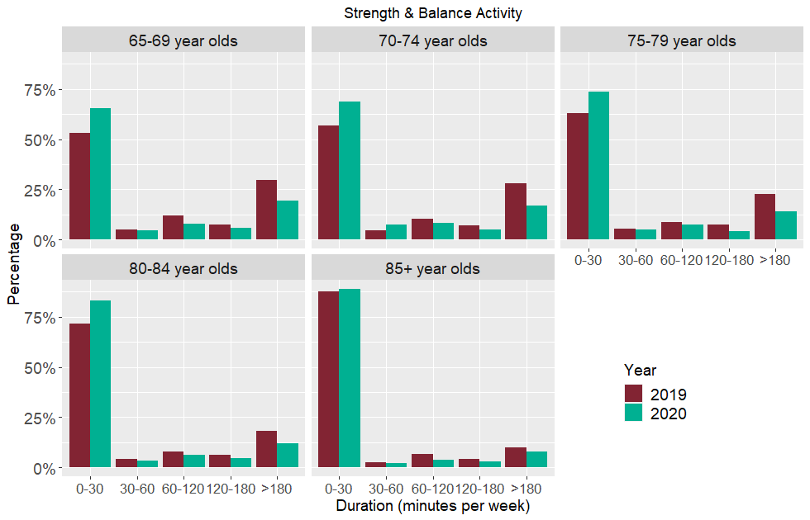
Wider impacts of COVID on health: physical activity in older adults
In all older adult age groups proportion of those doing the least activity increased and the proportion doing the highest levels decreased between 2019 and 2020
Strong evidence of the link between increasing physical activity and a reduction in both the number of people who fall and the number of falls
Report hypothesises that the inverse relationship is also true
Estimates 110,000 more older people will have at least one fall per year and the number of falls could increase by 124,000 for males and 130,000 for females
For each year that the lower levels of strength and balance activity persist, cost to health and care system of £211m as result of related falls.
Source: PHE Wider Impacts of Covid on Older people aged 65 and over https://www.gov.uk/government/publications/covid-19-wider-impacts-on-people-aged-65-and-over
Notes:
Report published by PHE in August 2021 using Sport England data on reduced physical activity rates during pandemic
Key to note – cost is only showing impact of additional falls. We know physical activity has numerous benefits including on mental wellbeing and long term conditions, so the impact of this deconditioning on older adults and on the system will in reality be much greater.

Slide 18
Addressing deconditioning
Report recommendations
Whole population actions
  Promote awareness of issue, the need to build up activity gradually
  Increased access to and promotion of strength and balance activity
  Falls prevention activities promoted in positive ways (reconditioning)
Targeted measures
  Support for individuals with appreciable functional loss from rehab, falls and physio services
  If related to post-acute Covid-19 syndrome, support from specialist services
What’s happening now?
Social care White Paper announced OHID-managed deconditioning inequalities fund
Regional network – Y&H Falls and Deconditioning Network
Deconditioning Games (East of England)
Active at Home resource
Place-based action
  MECC approach – guides to building up activity based on ability to stand unaided
  One-to-one walking support
  Green activity delivery
  Engagement of social prescribing services

Slide 19
The National Falls Prevention Coordination Group (NFPCG), the impact of COVID-19 and partnership working
Sue Dewhirst, NHS England

Slide 20
National Falls Prevention Coordination group (NFPCG)
Sue Dewhirst, Chair of the National Falls Prevention Coordination Group
-Population Health Services Manager, National Healthcare Public Health
NHSE/ I (Medical Directorate)

Slide 21
Presentation content
National picture
Falls-risk factors
National Falls Prevention Coordination Group (NFPCG)-Who are we? Partnerships and collaboration.
Falls and Fractures consensus statement and resources
4 Nations falls prevention group
Falls Prevention- A whole system approach

Slide 22
Falls-National picture
30% of people aged 65 and over will fall at least once a year
For people aged over 80 it’s 50%
Falls are the number one reason why older people are taken to the hospital accident and emergency departments
In around 5% of cases a fall leads to a fracture and hospitalisation
For people aged 60+, women are more likely to fall than men – 29.1% of women and 23.5% of men had a fall in previous 2 years (2016)
Unaddressed fall hazards in the home are estimated to cost the NHS in England around £435 million
Notes:
For people aged 60+, women are more likely to fall than men – 29.1% of women and 23.5% of men had a fall in previous 2 years
Source: Gale C, Cooper C and Sayer A, 2016, Prevalence and risk factors for falls in older men and women: The English Longitudinal Study of Ageing, Age and Ageing; 45: 789–794
https://www.ncbi.nlm.nih.gov/pmc/articles/PMC5105823/#afw129C4
Unaddressed fall hazards in the home are estimated to cost the NHS in England £435 million
Source: Nicol S, Roys M, Garrett H, BRE. The cost of poor housing to the NHS [Internet]. BRE Trust; 2016
Available from: www.bre.co.uk/filelibrary/pdf/87741-Cost-of-Poor-Housing-Briefing-Paper-v3.pdf
Emergency admissions are higher for older people
Source: Public Health Outcomes Framework, Emergency hospital admissions due to falls in people aged 65 and over - aged 65-79, 2017/18, England; Emergency hospital admissions due to falls in people aged 65 and over - aged 80+, 2017/18, England.
https://fingertips.phe.org.uk/profile/public-health-outcomes-framework
References and evidence to support falls prevention:
National Falls Prevention Coordination Group, 2019. Strength and Balance Quality Markers-supporting improvement.
https://www.gov.uk/government/publications/strength-and-balance-quality-markers-supporting-improvement
National Falls Prevention Coordination Group, 2017. Falls and Fractures consensus statement and resource pack.
https://www.gov.uk/government/publications/falls-and-fractures-consensus-statement
Royal College of Occupational Therapists, 2019. Adaptations without delay.
https://www.rcot.co.uk/news/rcot-launch-adaptations-without-delay-report
All Our Health-Falls Prevention (updated July 2019)-Information and resources for health professionals
https://www.gov.uk/government/publications/falls-applying-all-our-health/falls-applying-all-our-health
Public Health England and Centre for Ageing Better. 2018. Muscle and bone strengthening and balance activities (MBSBA) for general health benefits in adults and older adults: summary of a rapid evidence review for the UK Chief Medical Officers’ update of the physical activity guidelines.
https://assets.publishing.service.gov.uk/government/uploads/system/uploads/attachment_data/file/721874/MBSBA_evidence_review.pdf
Centre for Ageing Better, 2019. Raising the bar on strength and balance: the importance of community-based provision
https://www.ageing-better.org.uk/publications/raising-bar-strength-balance

Slide 23
Risk factors for falls
Very large number of falls risk factors (over 400). Significant ones include:
a history of falls
muscle weakness
poor balance
visual impairment
environmental hazards
polypharmacy and the use of psychotropic and anti-arrhythmic medicines,
+ a number of specific conditions including cognitive impairment, diabetes, high alcohol consumption, incontinence, Parkinson’s disease and stroke.
Focused NFPCG meetings and task & finish groups to address specific risk factors
Notes:
Falls are events, fractures are the injury resulting from the event.
Caused by a number of inter-related risk factors.
Prevention= systematic reduction of risks

Slide 24
The National Falls Prevention Coordination Group (NFPCG)
The NFPCG was hosted and chaired by Public Health England until 1st October 2021, leadership has moved to NHSE/I Medical Directorate/ Healthcare PH
Over 40 member organisations. Partnership working and Networks are key
National and regional representatives, including: NHSE/I, OHID, academia, CfAB, 3rd sector, CSP, AGILE, RCOT, College of Podiatry, AACE etc
4 Task & Finish groups–Deconditioning, Health inequalities, Eye health, P&P engagement
Initiated 4 Nations group January 2021, share priorities/ good practice
Resource development and dissemination of good practice (eg eye health, deconditioning, care homes/ EHCH, emergency services)
NFPCG Progress Report 2019-2021 published March 2021, focus on public health and ‘prevention’
NFPCG provided advice on the Wider Impacts of COVID report (August 2021)
NICE Guidance, CG161 falls in older people (2013) due for review, representation from NFPCG membership

Slide 25
Falls and Fractures Consensus Statement, Falls ROI tool, falls resources
Falls and fractures consensus statement (published February 2017) and Resource pack (July 2017) - details key interventions, approaches to commissioning plus national commitment for support and commissioners checklist -Takes a life course and whole system approach
2018 – A Return on Investment (ROI) calculator on the evidence based interventions
Quality improvement –the Strength & Balance Quality Markers paper, July 2019
All Our Health topic information on falls and fractures, updated January 2020 can be found here All Our Health (AOH)- Falls and Fractures e-learning
Falls FAQ Poster was developed for staff in care homes to support the management of a fall in care homes during the COVID 19 pandemic
NFPCG Task & Finish group on ‘deconditioning’ is developing a range of resources
Notes:
During the COVID pandemic NFPCG members worked on developing a variety of resources including:
-Keeping Well at Home booklet (University of Manchester)
-Active at home booklet (PHE/ Sheffield Hallam University/ Sport England)
-Home hazards checklist- worked with the Sussex Health and Care Partnership to develop a checklist for older people to help identify and address potential falls hazards in their homes
https://www.bgs.org.uk/resources/keeping-older-people-safe-and-well-at-home
Blog,’ Are you ready for the autumn and winter’? Key questions for people providing and planning local falls prevention services during the time of COVID-19. Published 13th July 2020 on the BGS website
https://www.bgs.org.uk/blog/are-you-ready-for-the-autumn-and-winter

Slide 26
Tackling Falls prevention across the 4 Nations
Group initiated in January 2021, Memorandum of Understanding
Concordat/ strategy in development, key priorities, share best practice and resources
Representatives include:
England-members from The National Falls Prevention Coordination Group (NFPCG)
Wales- Public Health Wales and Care and Repair Wales;
Scotland-Falls prevention in Acute Care; Public Health Scotland
N. Ireland- Public Health Agency (PHA), Falls Coordinators from regional Health and Social Care Trusts; Allied Health Professional (AHP) representative

Slide 27
Key interventions-requires a whole system approach
A whole system approach to falls prevention
Reducing health inequalities, improving access to services
Post COVID recovery, deconditioning in older people
Healthy homes including home adaptations and Technical aids
Case finding, risk assessment, referral according to need
Fracture Liaison Services (FLS), Care and residential homes
Strength and balance exercise programmes(eg AGILE/ Later Life training)
Notes:
Strength & Balance Quality Markers (published by PHE 29th July 2019)
Raising the Bar on Strength & Balance (published 2019, CfAB/ UoM/Later Life Training)
The key single intervention for reducing rate of falls (Cochrane review 2019)
Could extend the focus beyond physical activity (physios) and home safety (OTs) by making the link between feet footwear (podiatry), diet and nutrition (dieticians), vision (optometrists) etc
Case finding? or is it right care right time i.e. segmentation according to need with clear pathways relative to where person presents e.g. self directed/self mx, falls risk identified in contact with Healthcare professional, versus those who need specialist input from falls experts in community/health care, via FLS services etc
Falls Response Governance Framework, October 2020
https://aace.org.uk/resources/falls-response-governance-framework-for-nhs-ambulance-trusts/
Falls prevention amongst older people using digital technologies during COVID-19 home isolation and physical distancing. NIHR/ Healthy Ageing Research Group University of Manchester, 2020
https://www.opfpru.nihr.ac.uk/covid-19-research/rr7-covid-19-technology-for-strength-and-balance/

Slide 28
Thank you for listening-Any questions?
Contact details:
Sue.Dewhirst@phe.gov.uk

Slide 29
Delivering physical activity programmes for older people across Greater Manchester
Beth Mitchell, GreaterSport

Slide 30
Active Ageing Lead
Beth Mitchell
Notes:
What is GreaterSport and how it is designed to deliver?
How does GreaterSport collaborate with national and local organisations?

Slide 31

Notes:
Strategy:
GM Moving in Action – is the name of the strategy
Shaped and powered by GM Moving as GM's movement for movement
‘In action' - personally, in our orgs, communities, neighbourhoods, as a system
Mission is Active Lives for All

Slide 32
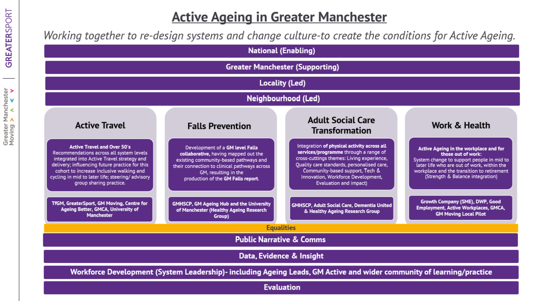
Notes:
Give an overview of programmes or messaging developed or delivered by GreaterSport related to physical activity and older people.

Slide 33
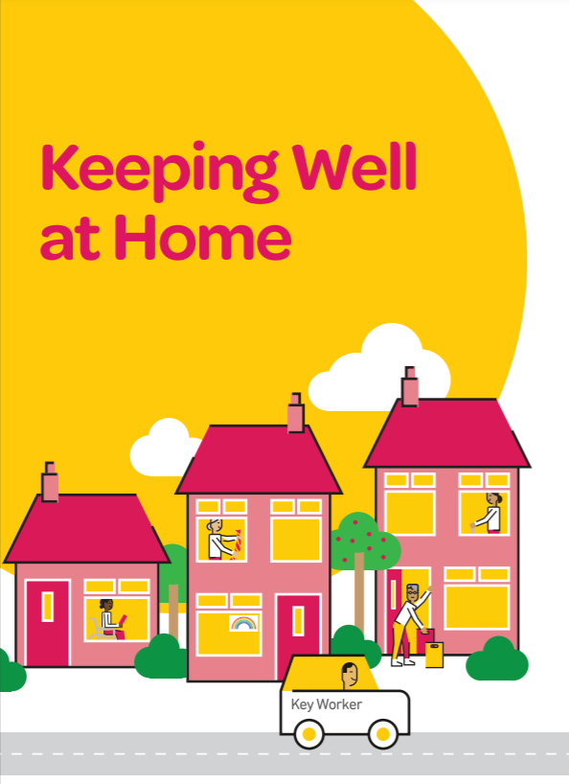
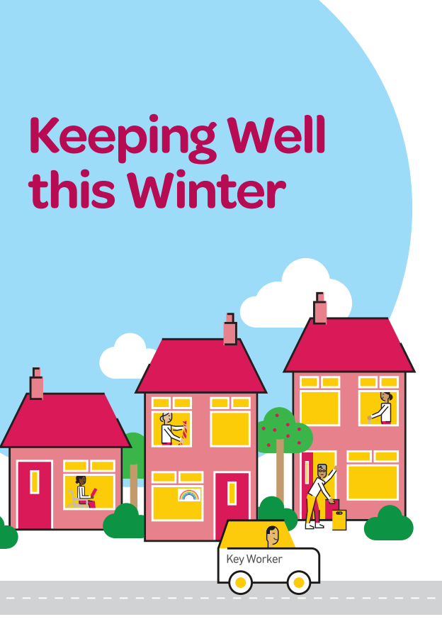
‘Keeping well at home’ &
‘keeping well this winter’ campaigns
GM Ageing Eco-system collaboration
Keeping Well at Home
May 2020
A guide to help older people stay healthy at home during the COVID-19 lockdown
Aimed at older people not online
Draws on evidence-based research from the University of Manchester
67,000 printed booklets distributed across Greater Manchester​
300,000 printed booklets distributed across the UK including 9 local versions
Keeping Well this Winter
December 2020
Keeping Well this Winter booklet, film and talking tips guide
136,000 printed booklets (English) distributed across Greater Manchester ​
1,900 views of the film on GMCA YouTube channel
Distribution via local councils, housing providers and VCSE partners
Resources as part of the campaign:
Talking about this Winter video (TAMG)
https://www.youtube.com/watch?v=1RCmHqTL0vA
Keeping Well This Winter Talking Tips
https://www.greatermanchester-ca.gov.uk/media/3897/kwtw-talking-tips-guide.pdfhttps://www.greatermanchester-ca.gov.uk/media/3897/kwtw-talking-tips-guide.pdf

Slide 34
Q&A session
Dr Alison Giles, formerly Centre for Ageing Better

Slide 35
Share the report
An online version of the report can be found at:
www.physoc.org/covid19resilience

